Slide 1
Automated Resume Parsing and Application Processing of Unsolicited Applications in SuccessFactors Recruiting
<Business - AI/>

Slide 2

Team
Product Owner (Functional SME) | : |  | Gopalraj
Architect (BTP and AI SME) | : |  | Vijay Madhavan
Developers
BTP & AI Developer | : |  | Shubham Khewaram Lanje
CAPM Developer | : |  | Shubham Khewaram Lanje
Functional SME | : |  | Utsav Sen
Scrum Master (BTP and AI Governance) | : |  | Vasudevan Kalyanaraman

Slide 3
Solution Overview
Automation of Unsolicited Application Processing within SuccessFactors Recruitment |  | ​
Line of Business​ | Across all Line of Business​ | Industry​ | Across all industries​
Current Business Scenario & its Challenges​ | It is estimated that around 15 to 20 percent of positions are filled as a result of unsolicited applications (also called cold, spontaneous, direct, etc.) in any Organization. Many a times Organizations face challenges in managing Unsolicited applications (even with Robust systems & processes in place) and some of the key ones being; Loss of talent: If unsolicited applications aren't processed properly, organizations risk overlooking potentially valuable candidates who could be a strong addition to the team. Negative company image: Missed applications can leave a negative impression on a company and damage the company's Employer brand if it happens often. GDPR violations: Unprocessed data can lead to a violation of the General Data Protection Regulation (GDPR), which can result in serious fines. Resource consumption: Unstructured handling of unsolicited applications can lead to unnecessary messes that require a lot of time to straighten out. Handling unsolicited job applications correctly can save the Organisation time and resources that could be used for other, more important tasks. Missing opportunities for analysis: Without a systematic approach to handling unsolicited applications, Organizations risk missing out on valuable data that can help improve their recruitment strategy. ​
Description of Solution​ | LTIMindtree has built an SAP AI Service based working model that will use Document Management service to Parse Unsolicited Candidate Resume / Profile, consolidate key information from the profiles in a structured format and use the information to register candidates and post applications against suitable Job postings. Following are the key capabilities of planned Automated SAP Gen-AI solution Automated Resume Parsing capabilities to pick Key Header information on the candidate (Example – Candidate Profile, Contact Number, Educational Qualification, Profile Summary, Address and E-mail) and Line-item information on previous work experience SAP Gen-AI capability & API service To refine candidate Data and complete registration of Candidate profiles, To Identify job postings matching the candidate profile and experience and apply against the job postings
SAP Products or BTP components used​ | SAP BTP BPA, AI Core, DMS, CAPM
Business Need / Value Proposition for Customers​ | Automated Resume Parsing functionality using SAP Document Information extraction service and refinement of candidate data using Gen-AI service. This data will be used to register the candidate in SuccessFactors instance without any manual effort Automated job posting search & application based on the candidate experience and qualification which will help to track candidate selection status and save time & effort for recruiting administrators
Possible Pilot Customers​ | ​Molnlycke Health Care, Dentons | Market Segment​ | All​

Slide 4

Automation of Unsolicited Candidate Application Processing with Integration to SAP- SuccessFactors
Objectives
Challenges
Solution Approach
Automate the End-To-End Process of Unsolicited Candidate Application processing with Seamless Integration to SAP SuccessFactors Recruiting Module
Conversion of unstructured candidate profiles from Unsolicited sources to Structured format manually lead to Redundancy and Manual effort
Gen-AI based solution build on SAP BTP platform to integrate outlook account to parse candidate resumes/ profile and convert candidate identifiable information to a structured format and establish systemized integration to SAP-SuccessFactors instance
01
02
03
Automated conversion of Unstructured candidate Information to a structured format
Unsolicited Candidate Application Mismanagement can lead to GDPR Noncompliance
GEN AI capabilities
Optical Character Recognition
Systemized API connectivity to SAP SuccessFactors Recruiting
Intelligent recommendations on Best Fit candidate for a Vacancy using logical Algorithms
Seamless Integration of Candidate Profile Data with SAP SuccessFactors Recruiting
No Out-of Box SAP SF solution is available to manage Unsolicited Candidate Applications
Intelligent recommendations based on Systemized Algorithms to decide on Best candidate fitment for a Vacant Position
Leverage Core AI
Recognize character attributes from Profile
Verification for Candidate profile Uniqueness is Time and Effort intensive exercise to be done manually
Ingenuity to identify Candidate Profile Uniqueness
Dashboard to provide cross section view of candidate's profile match to Vacancies
Exploit the BTP capabilities
Schedule an Unattended Process Trigger
Establish a seamless integration with Custom Apps to SuccessFactors Recruiting
Dashboard to provide cross section view of candidate profile against Open vacancies
No Standard Out-Of-Box integration solution available to seamlessly process Unsolicited Candidate application in SAP SuccessFactors Recruiting
Limitations
Benefits
Manual Processing
Disparate Systems
Redundancy in Candidate selection
GDPR compliance
End - To - End Automation
Intelligent recommendations
Systemized Integrations
Summary Dashboard

Slide 5
Business Value Proposition
Minimize
Maximize
Modernize
Manual tracking of Unsolicited candidate profile consolidation
Manual verification of Candidate Profile Sanctity / Uniqueness
Mis-Management of Eligible candidates to be considered for suitable vacancies
Time-To-Fill Key Vacancies
Efficiency in management of Unsolicited Candidate profiles
System checks in validating Candidate profiles before registration in Successfactors instance
Application processing against valid Job Postings
Candidate Profile Match up against Job Vacancies with Required Skills and experience
Recruiting Admin experience with Analytics
System driven Candidate registration and application
01
02
03
Business Benefits
Improved Unsolicited Candidate Application Processing
20% reduction in Time-to-Fill key positions
Improved Unsolicited Candidate profile verification
60% improvement in Unsolicited Candidate Profile Management

Slide 6



Automate Unsolicited Application Processing with Gen AI capabilities in SAP SF:
Unsolicited Candidate Application
Candidate Registration
Job Posting Overview & Profile Match
Analytics
Resume Parsing from E-mail attachment
(GenAI document data extraction)
Validate Candidate Data available in SF
(Gen AI key field match in profile)
Retrieve Valid Job Postings from SuccessFactors Instance
Cross section View of Candidate profile match against Vac. requisitions
Candidate Profile Consolidation
Automated Candidate Registration in SF
Gen AI based Candidate best Profile Match based on Skill & Experience
Profile Verification for Uniqueness
Candidate Application submission in SF
Opportunities to
create value
Legends
Manual Intervention
Profile Attachment Parsing & DMS
Automated Registration in Candidate Talent pool
AI Driven Profile Match up & Fitment Analysis
Reduced Time-To-Fill Key Vacancies
Gen AI
Process Automation

Slide 7
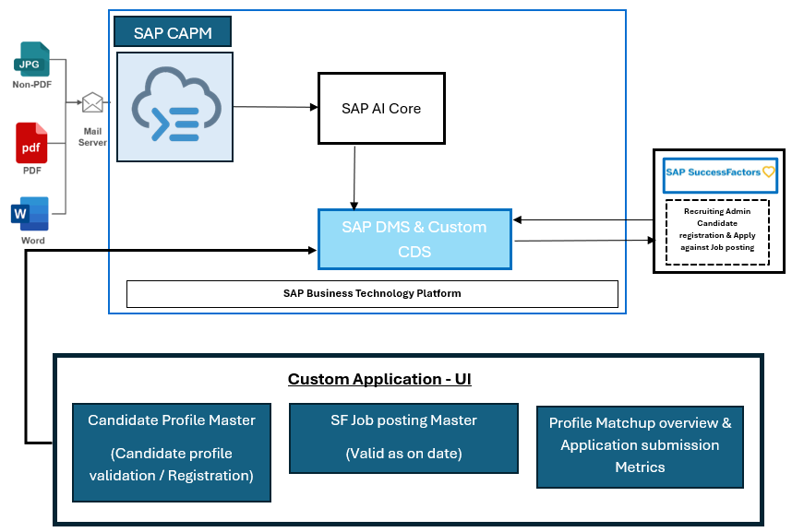
Architecture
BTP Services
SAP CAPM
SAP Hana DB
SAP BTP BPA
SAP BTP UI5
SAP BTP DMS
AI Features
SAP BTP AI Core
Chat GPT 3

Slide 8
Business Opportunities
Sr | Customer | Status | Remarks
1 | Molnlycke Health Care | Automation overview provided. Demo Date to be finalized | Customer appraised of Opportunity. Demo Date to be finalized
2 | Dentons | Discussion Initiated. Demo date to be finalized

Slide 9




Getting to the
future, faster. Together.

